Slide 1

Project Management System
Project Guide: Prof. Manoj Kumar Behera
Assistant Professor, Dept of Computer Science
Contributors: Priyanka Pattnaik (160301120001)
Dhruba Ghosh (160301120010)
Shubrat Saha (160301120013)
Notes:
Notes to presenter:
What is your purpose for sharing this reflection?
Is it at the end of a unit or project?
Are you sharing this reflection, at the attainment of a learning goal you set for yourself?
Is it at the end of a course?
State your purpose for the reflection or even the purpose of the learning experience or learning goal. Be clear and be specific in stating your purpose.

Slide 2

Project Objective
Bridging the gap between Workflows, Timely Delivery and insights generation
Maintaining transparent transactions automatically
Accurate and timely reporting
360 degree view of work status
A secured storage to save data generated by run time task flows
Flexible Work Flow Monitoring
Scalability in Cloud Platform
Notes:
Notes to presenter:
Description of what you learned in your own words on one side.
Include information about the topic
Details about the topic will also be helpful here.
Tell the story of your learning experience. Just like a story there should always be a beginning, middle and an end.
On the other side, you can add a graphic that provides evidence of what you learned.
Feel free to use more than one slide to reflect upon your process. It also helps to add some video of your process.

Slide 3

Introduction

Slide 4
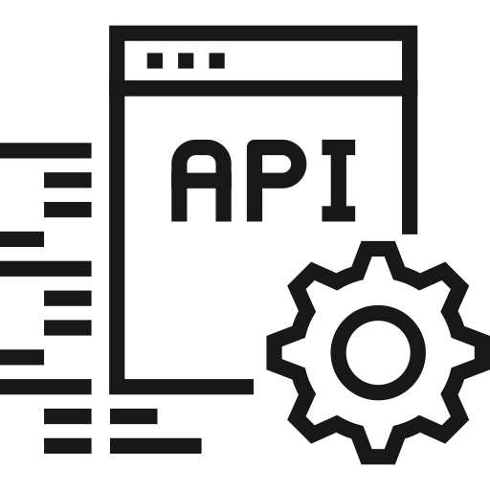



Major Tasks Focused
Database Design & Implementation
Design REST APIs
Cloud Deployment
LAMP Server Setup
Notes:
Notes to presenter:
What did you think at first?
What obstacles did you encounter along the way?
How did you overcome those obstacles?
What images can you add to support your process?
This SmartArt allows you add images and text to help outline your process. If a picture is worth a thousand words, then pictures and words should help you communicate this reflection on learning perfectly! You can always click on Insert>SmartArt to change this graphic or select the graphic and click on the Design contextual menu to change the colors.
Feel free to use more than one slide to reflect upon your process. It also helps to add some video of your process.

Slide 5
Software Requirements
Any Browser (Microsoft Edge, Google Chrome, etc.)
Any Operating System (Windows, Android, Linux, etc.)
Internet Connectivity

Slide 6

Modules
Project Management System
Cloud Deployment
Database Design
Database Implementation
Setting up LAMP server
Development of REST APIs
Creation of Amazon EC2 instance
Setting up LAMP server
Deploying REST APIs in cloud
Notes:
Notes to presenter:
What was important about this learning experience?
How is it relevant to your course, yourself, or your society or community?
Why is this significant?
This SmartArt allows you add images and text to help outline your process. If a picture is worth a thousand words, then pictures and words should help you communicate this reflection on learning perfectly! You can always click on Insert>SmartArt to change this graphic or select the graphic and click on the Design contextual menu to change the colors.

Slide 7
ER DIAGRAM

Slide 8
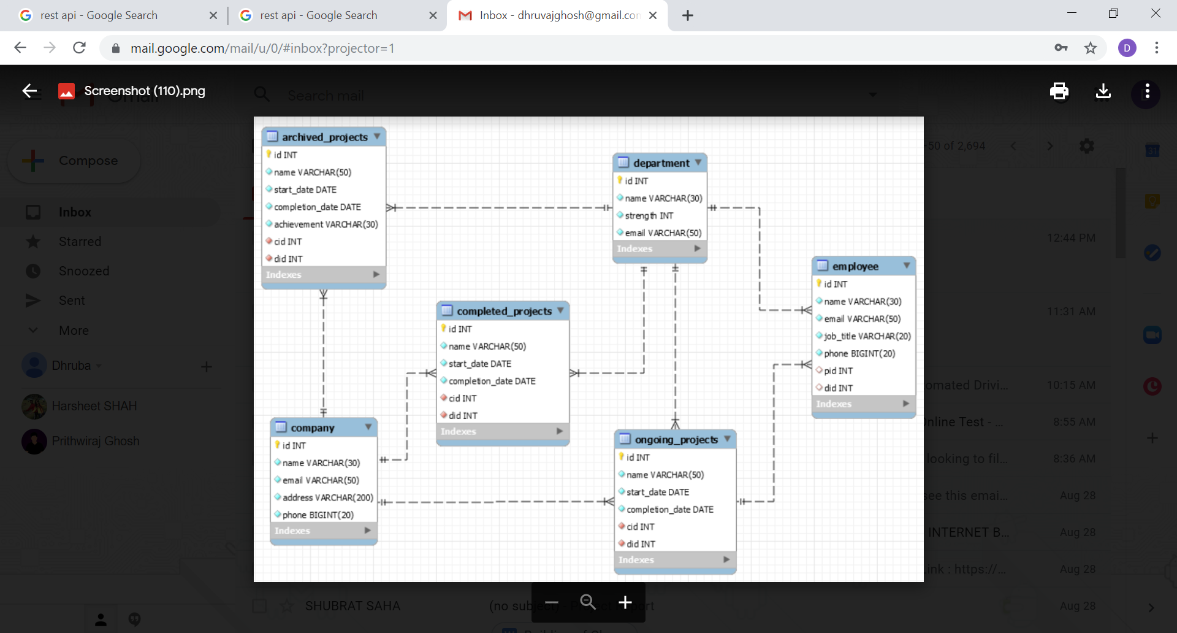
ER Diagram
Notes:
Notes to presenter:
What did you think at first?
What obstacles did you encounter along the way?
How did you overcome those obstacles?
What images can you add to support your process?
This SmartArt allows you add images and text to help outline your process. If a picture is worth a thousand words, then pictures and words should help you communicate this reflection on learning perfectly! You can always click on Insert>SmartArt to change this graphic or select the graphic and click on the Design contextual menu to change the colors.
Feel free to use more than one slide to reflect upon your process. It also helps to add some video of your process.

Slide 9
API DEMONSTRATION

Slide 10
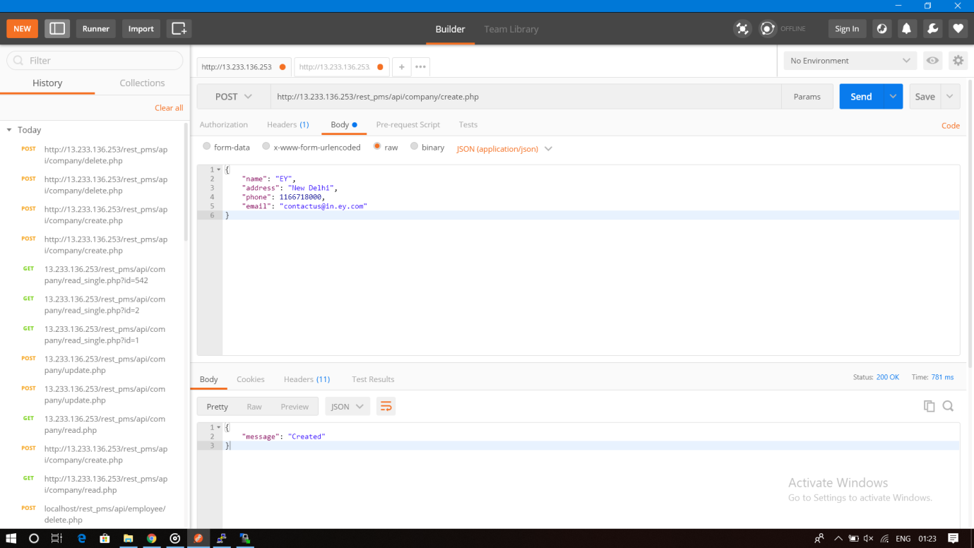

Slide 11
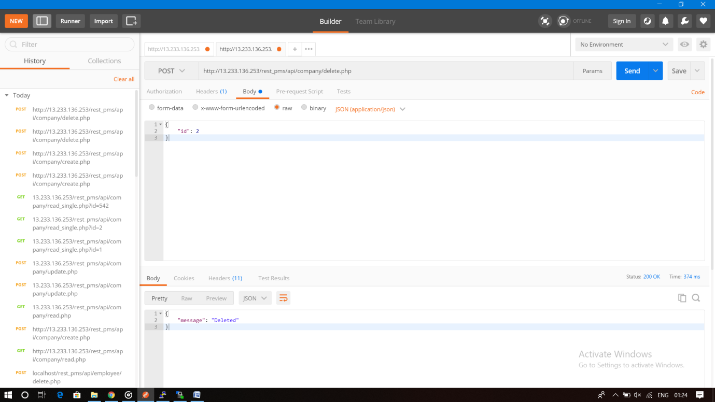

Slide 12
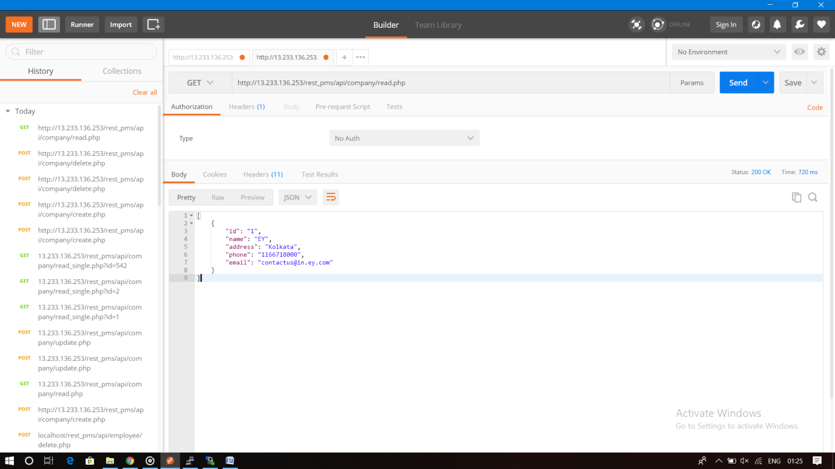

Slide 13
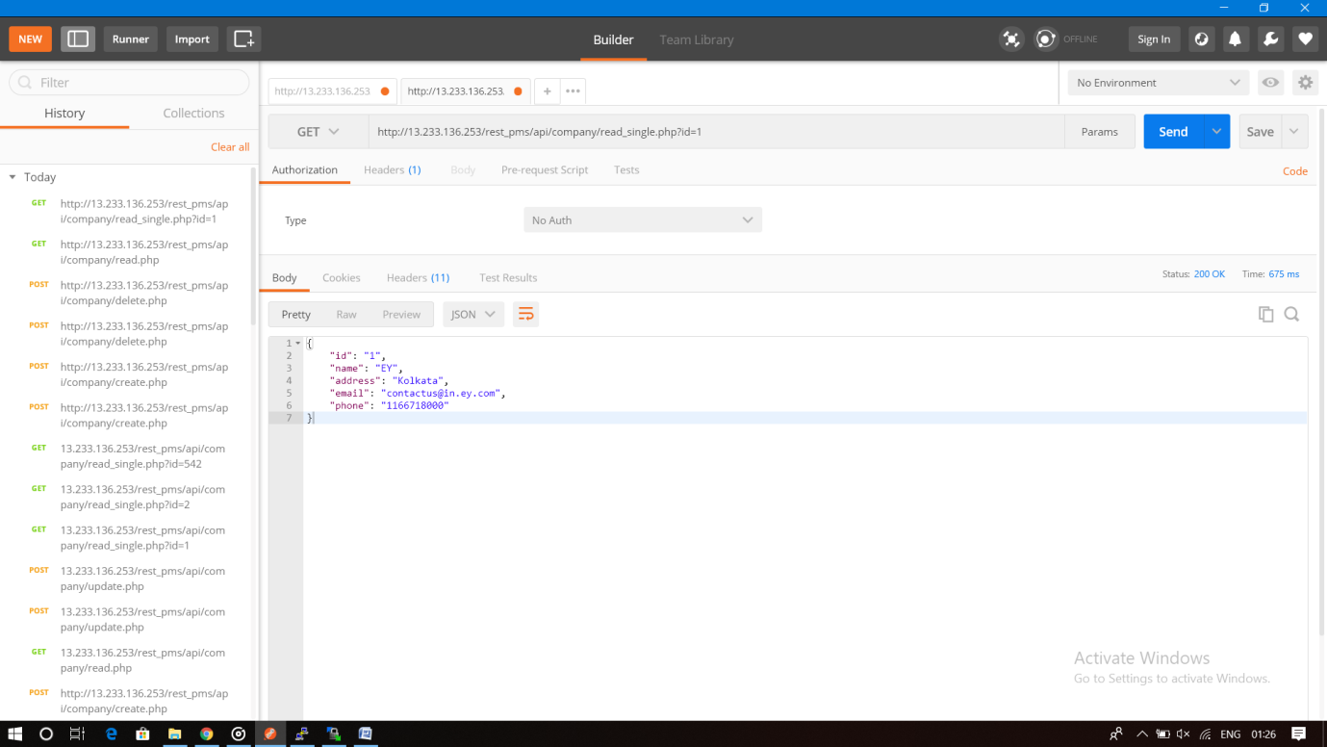

Slide 14
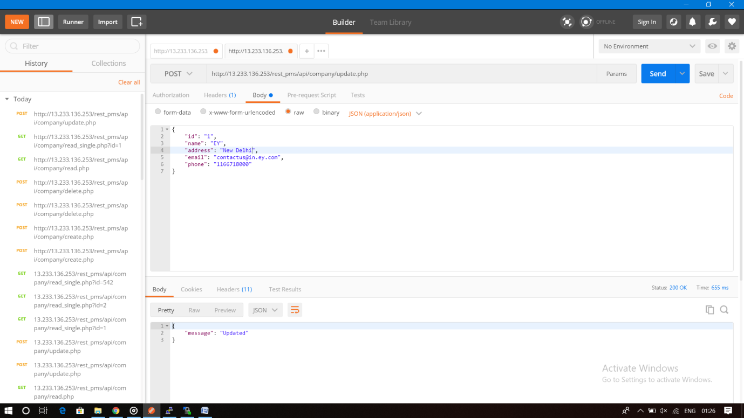

Slide 15
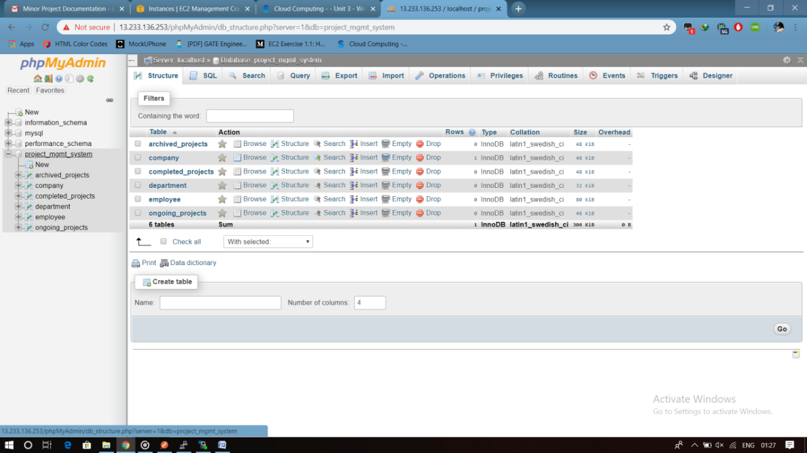

Slide 16
THANK YOU

